Slide 1
Traffic Prediction Analysis using Machine Learning techniques
University Name
Submitted By:

Slide 2
Introduction
The primary purpose of this project is to predict traffic congestion at junction areas on road networks by implementing various predictive models using three distinct machine learning models.
The most performing model among those implemented will be considered and selected as the best model for this task. .
In order to choose the best model, several techniques like Mean Absolute Error, Mean Squared Error and accuracy prediction were employed. Using these techniques we were able to observe and select the best model performing model.

Slide 3
Literature Review
Traffic congestion areas are the most vulnerable areas affected by traffic. Most research studies have been doing research mostly in urban centers of the country. This is because of the perspective that urban areas are the most congested places where traffic gets transmitted easily.
However, the junction areas on road networks have been neglected and not considered as one of the areas that can generate traffic and be transmitted to the other points connected to the junction.
In this research project, we identified the gap and decided to work on the traffic congestion at the junction areas as another source of traffic generation and transmission on road networks.

Slide 4
Project Work Flow
Data Pre Processing
Data Collection from data science platforms
Exploratory Analysis
Model Training
Model Evaluation
Model selection

Slide 5
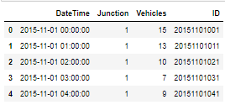
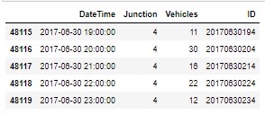

Data Collection
1. Data Collection:
We collected the junction dataset from Kaggle , the link is provided as follows; https://www.kaggle.com/datasets/fedesoriano/traffic-prediction-dataset
Below shows the first 4 entries, last 4 entries, and sample of a cleaned data.
Sample data

Slide 6
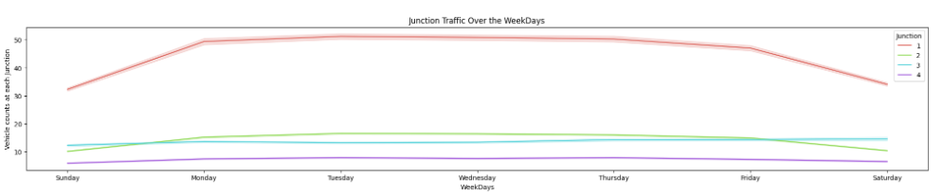
Exploratory Analysis
1. Junction Traffic Over the Weekdays
It is confirming the above findings that Saturday & Sunday there is less traffic across all the Junctions as compare to the weekdays (Monday-Friday).
Notes:
import geonamescache
from city_to_state import city_to_state_dict

Slide 7
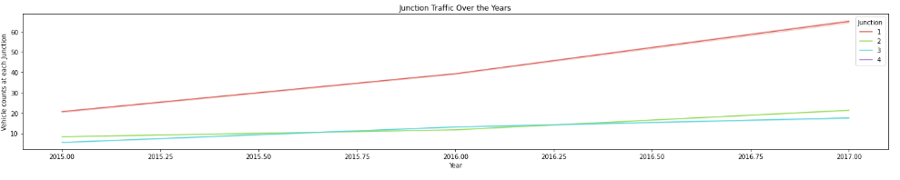
Exploratory Analysis
2. Junction Traffic Over the Years
From the graph it is evident that traffic is increasing every year and more so at Junction-1
Notes:
For the classification of tweets according to their security relevance, two classifiers have been explored:

Slide 8
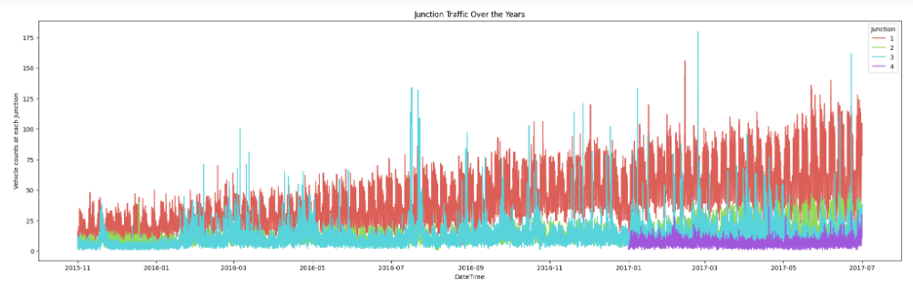
Exploratory Analysis
3. Junction Traffic Over the Years
We discovered that the first junction had the highest overall vehicle counts, as seen in the below group by. It also has an upward trend, implying that traffic will continue to increase over time. The second junction has the greatest peak bars, indicating a high number of cars for a specific month - these can be classified as outliers. The third junction shows a modest upward trend but a consistent flow throughout time. The fourth junction contains little data, as we observed in our previous study section; only 2017 incomplete data is present.
Notes:
For the classification of tweets according to their security relevance, two classifiers have been explored:

Slide 9
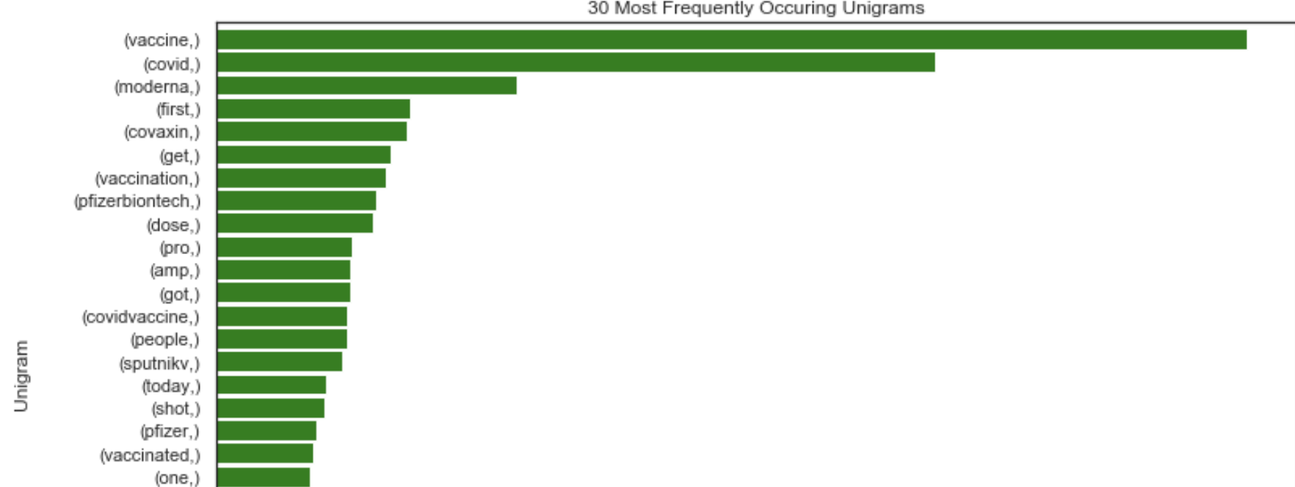
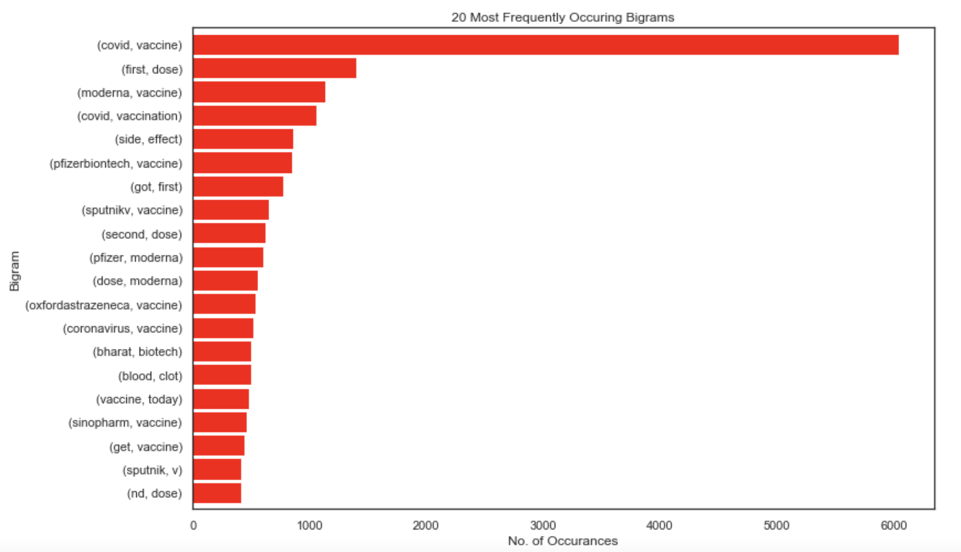
Text Processing
Remove punctuations, mentions hashtags, urls
Tokenization - Converting a sentence into list of words
Remove stopwords, Lemmatization- Transforming any form of a word to its root word
Plotted the Unigram, Bigram and trigram of frequently occurring words

Slide 10
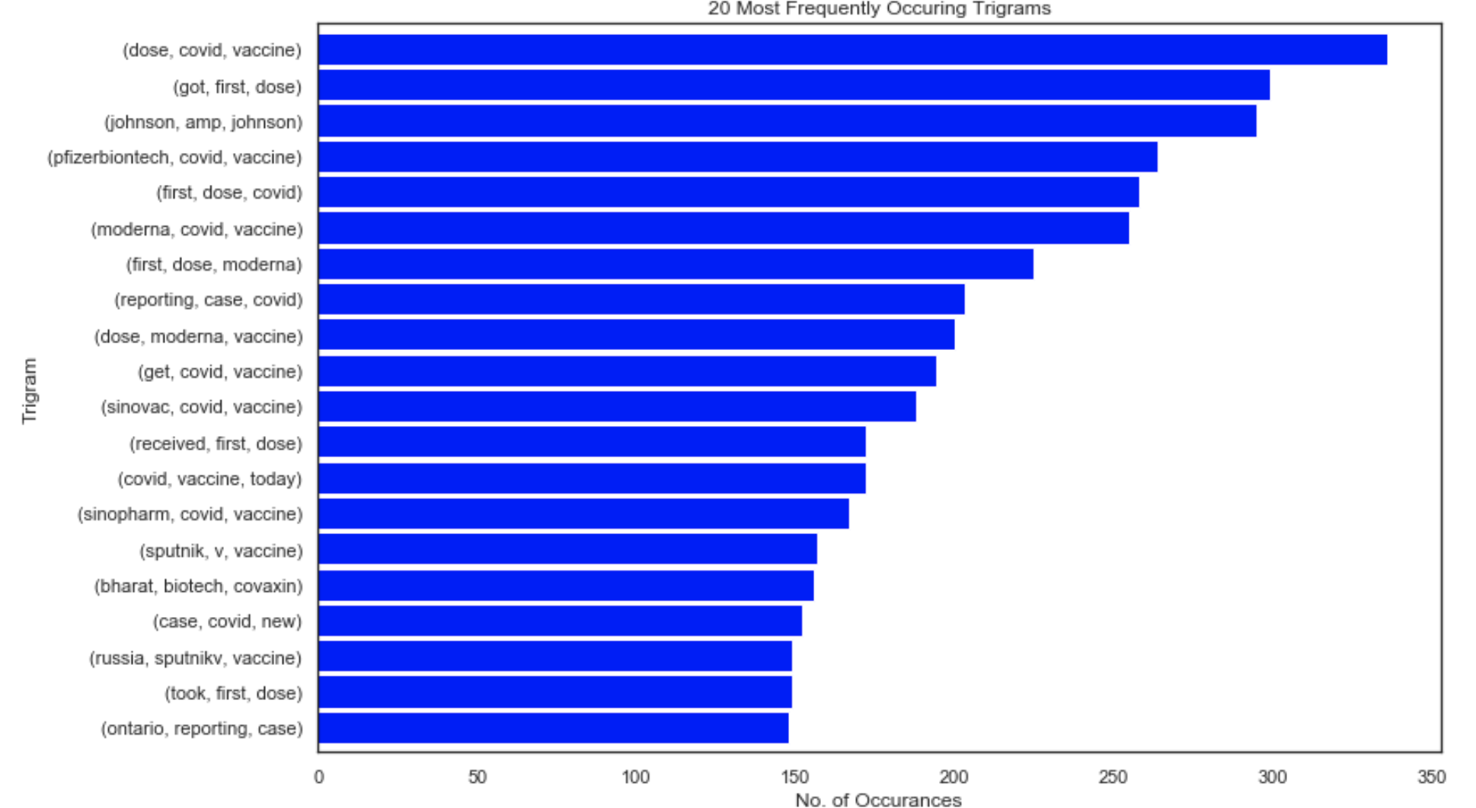
Text Processing
Trigrams

Slide 11
Sentimental Analysis using VADER
Import VADER((Valence Aware Dictionary and sEntiment Reasoner) model and using its methods, define separate functions to return compound, positive, negative and neutral scores.
It is available in the NLTK package and can be applied directly to unlabeled text data.
This method combines a lexicon approach with a rule-based approach to provide a high level of accuracy when scoring sentiment on social media.
The sentiment analyzer is run by passing each string to the polarity_scores method.
The result is a dictionary with four elements: neg, neu, pos, and compound.
These represent the negative, neutral and positive sentiment as measured by the analyser plus a combination of the scores to produce an overall sentiment value.
neg, neu, pos, are in the range 0 to 1, whereas the compound result is between -1 and +1
Negative value represents a negative sentiment value and positive value means a positive sentiment. A value around zero means that the sentiment expressed is neutral.
Notes:
VADER sentimental analysis relies on a dictionary that maps lexical features to emotion intensities known as sentiment scores. The sentiment score of a text can be obtained by summing up the intensity of each word in the text.

Slide 12
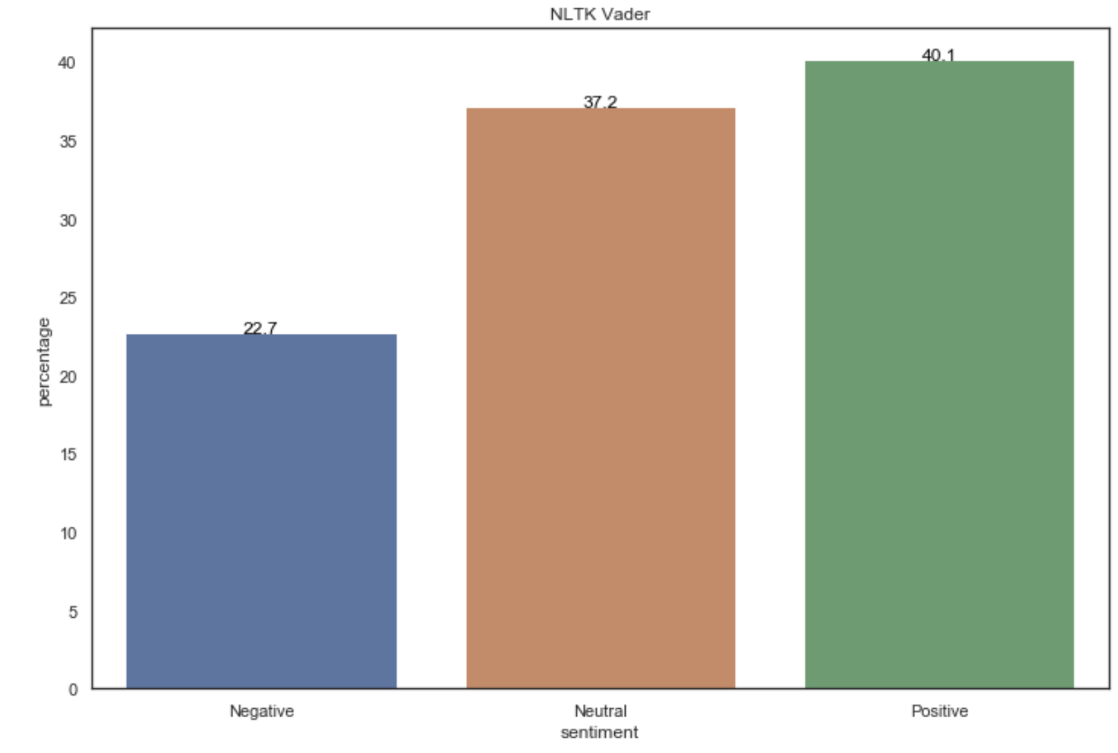
Sentimental Analysis using VADER
Using compound score on cleaned text
Percentage of positive tweets: 40.1%
Percentage of negative tweets: 22.7%
Percentage of neutral tweets: 37.2%
Using compound score on raw text
Percentage of positive tweets: 39.80%
Percentage of negative tweets: 21.96%
Percentage of neutral tweets: 37.44%
Notes:
VADER sentimental analysis relies on a dictionary that maps lexical features to emotion intensities known as sentiment scores. The sentiment score of a text can be obtained by summing up the intensity of each word in the text.
Notice that VADER:
It is case sensitive. The sentence This is great has a different score than the sentence This is GREAT.
Punctuation matters. The exclamation marks for example have a positive score
The emojis have also a score and actually very strong sentiments. Try the <3, :) , :p and :(
Words after @ and # have a neutral score.

Slide 13
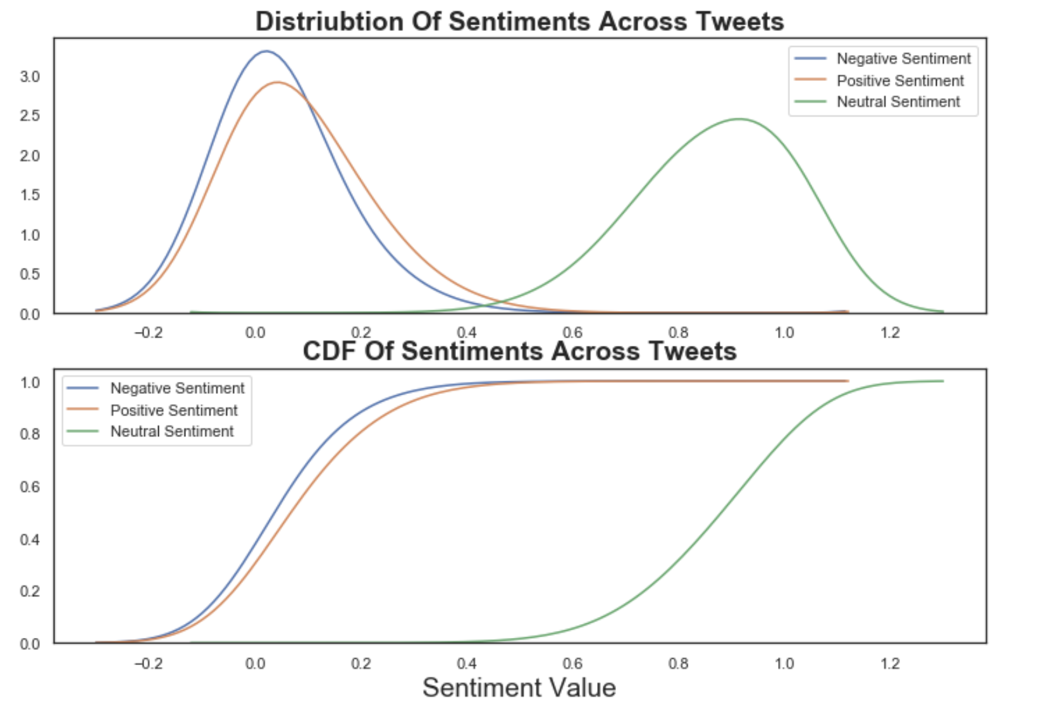
Sentimental Analysis using VADER
Distribution of Sentiments
A kernel density estimate (KDE) plot is a method for visualizing the distribution of observations in a dataset, analagous to a histogram.
KDE represents the data using a continuous probability density curve in one or more dimensions
The distributions of the sentiments indicates a normal distribution; the negative and positive sentiments are very similar
Notes:
VADER sentimental analysis relies on a dictionary that maps lexical features to emotion intensities known as sentiment scores. The sentiment score of a text can be obtained by summing up the intensity of each word in the text.
Notice that VADER:
It is case sensitive. The sentence This is great has a different score than the sentence This is GREAT.
Punctuation matters. The exclamation marks for example have a positive score
The emojis have also a score and actually very strong sentiments. Try the <3, :) , :p and :(
Words after @ and # have a neutral score.

Slide 14
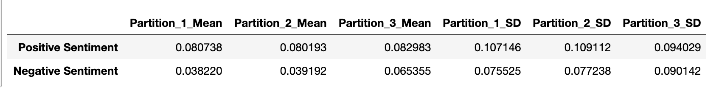
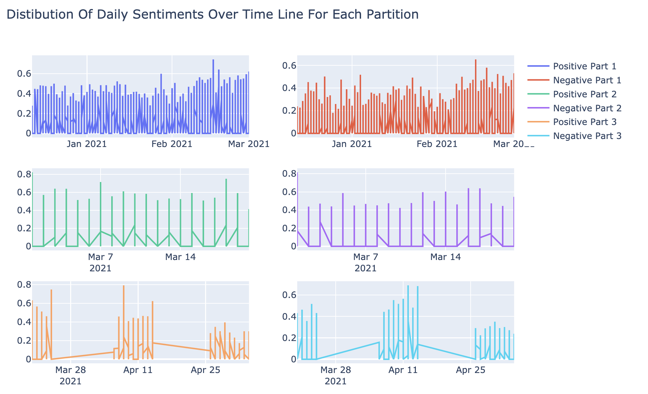
Sentimental Analysis using VADER
Daily Distribution of Sentiments over time
Divided into 3 partitions and calculated the mean and std deviations for each
Dec 2020- March 2021 higher density of positive tweets
March & April density of daily tweets seem to be less
Notes:
VADER sentimental analysis relies on a dictionary that maps lexical features to emotion intensities known as sentiment scores. The sentiment score of a text can be obtained by summing up the intensity of each word in the text.
Notice that VADER:
It is case sensitive. The sentence This is great has a different score than the sentence This is GREAT.
Punctuation matters. The exclamation marks for example have a positive score
The emojis have also a score and actually very strong sentiments. Try the <3, :) , :p and :(
Words after @ and # have a neutral score.

Slide 15
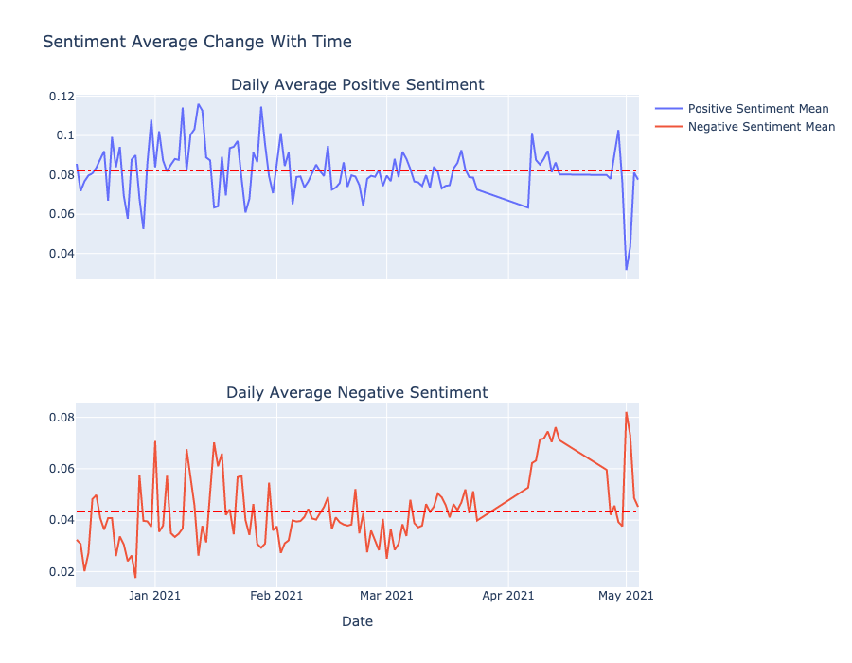
Sentimental Analysis using VADER
Distribution of Sentiments over time
Positive and Negative Sentiment mean from Dec 2020 to April 2021
From 18 December to December 29 there is a decline in the strength of the average negative sentiment, this could possibly be becasaue the U.S. Food and Drug Administration issued authorization for the use of Pfizer-BioNTech vaccine on Dec 14,& Moderna on Dec 18
Notes:
VADER sentimental analysis relies on a dictionary that maps lexical features to emotion intensities known as sentiment scores. The sentiment score of a text can be obtained by summing up the intensity of each word in the text.
Notice that VADER:
It is case sensitive. The sentence This is great has a different score than the sentence This is GREAT.
Punctuation matters. The exclamation marks for example have a positive score
The emojis have also a score and actually very strong sentiments. Try the <3, :) , :p and :(
Words after @ and # have a neutral score.

Slide 16
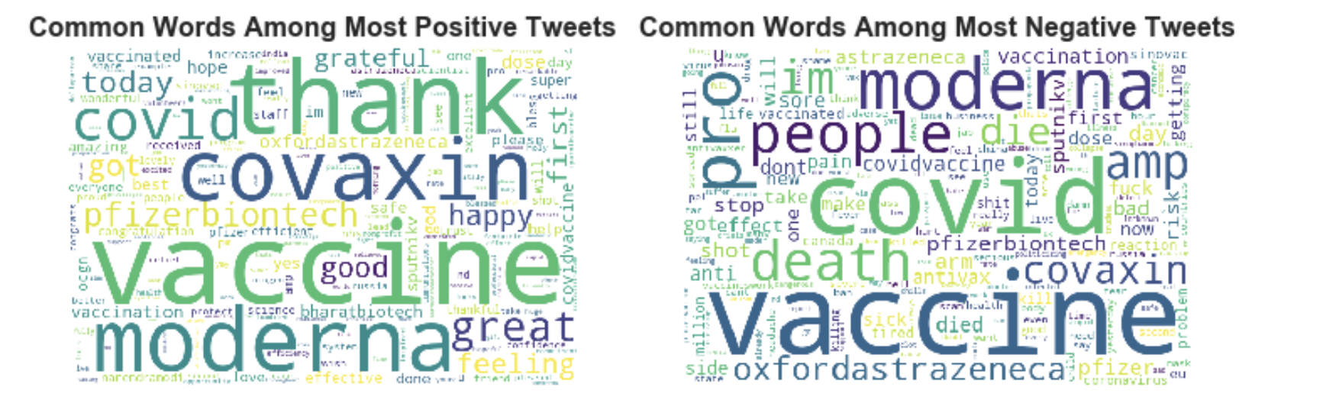
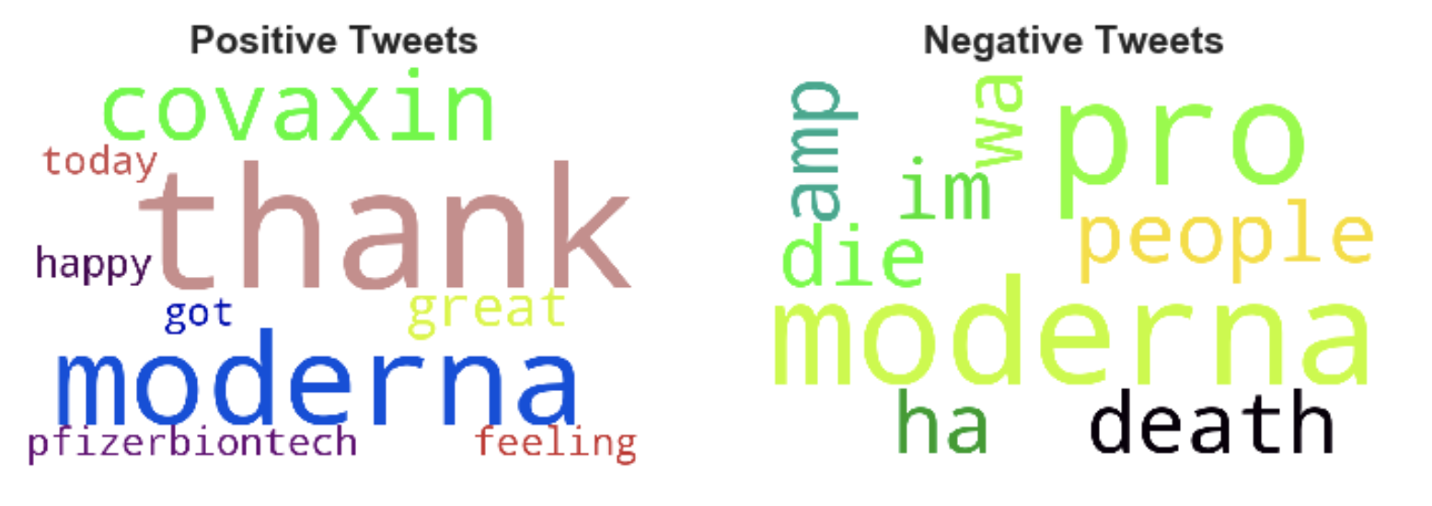
Sentimental Analysis using VADER
Word Cloud of Most common positive & Negative tweets
Word Cloud of top 10 positive & Negative tweets: After removing terms covid ,vaccine
Notes:
VADER sentimental analysis relies on a dictionary that maps lexical features to emotion intensities known as sentiment scores. The sentiment score of a text can be obtained by summing up the intensity of each word in the text.
Notice that VADER:
It is case sensitive. The sentence This is great has a different score than the sentence This is GREAT.
Punctuation matters. The exclamation marks for example have a positive score
The emojis have also a score and actually very strong sentiments. Try the <3, :) , :p and :(
Words after @ and # have a neutral score.

Slide 17
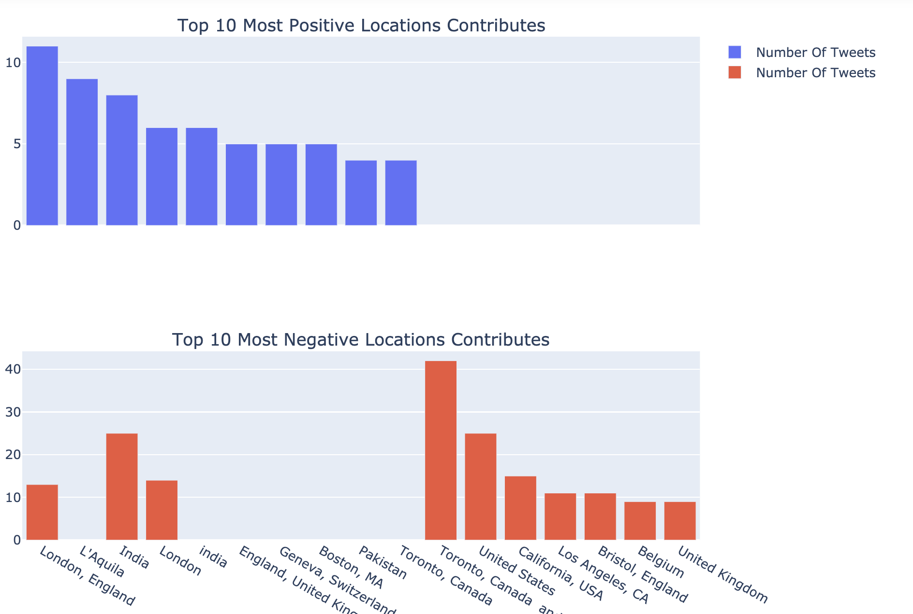
Location of Tweets based on sentiment
Have
London is seen to have high number of positive tweets
Toronto ,Canada seems to have high number of negative tweets.
Note: The location data has duplicates
Have tried using geonamescache , a Python library that provides functions to retrieve names of continents, countries as well as US states and counties as Python dictionaries.
However, it didn’t give the desired results
Notes:
VADER sentimental analysis relies on a dictionary that maps lexical features to emotion intensities known as sentiment scores. The sentiment score of a text can be obtained by summing up the intensity of each word in the text.
Notice that VADER:
It is case sensitive. The sentence This is great has a different score than the sentence This is GREAT.
Punctuation matters. The exclamation marks for example have a positive score
The emojis have also a score and actually very strong sentiments. Try the <3, :) , :p and :(
Words after @ and # have a neutral score.

Slide 18
Conclusion
Based on the sentiment analysis done, we learned that:
The dominant sentiment of covid vaccine-related tweets are positive.
The tweets tend to be more positive than negative on average.
The sentiment data is not stationary and there are also less in number of daily tweets in the month from March end to April first week to thus making it difficult to predict for people will feel about the vaccine with the current data.
There was a trend of decreasing negative sentiment strength from the 18th of December to the 27th, which was when the started vaccination.
There are recurring words both in the extremely negative and extremely positive tweets.
Some locations tend to be more negative/positive than others on average.
The sentiment strength of a tweet helps us to determine how the population is reacting to the vaccine; this can help the government to channel their advertisements towards more negative groups that usually refuse to believe in the integrity of the vaccine and observing the change over time

Slide 19
Future Work
Conduct the analysis on a larger amount of tweets
Compare text analysis results with other packages eg, Textblob
Improve the model to design a suitable cut off for positive and negative tweets, PyMC3 is a Python package for Bayesian statistical modeling and Probabilistic Machine Learning which focuses on advanced Markov chain Monte Carlo and variational fitting algorithms.

Slide 20
Thank You!
Any questions?

